Slide 1
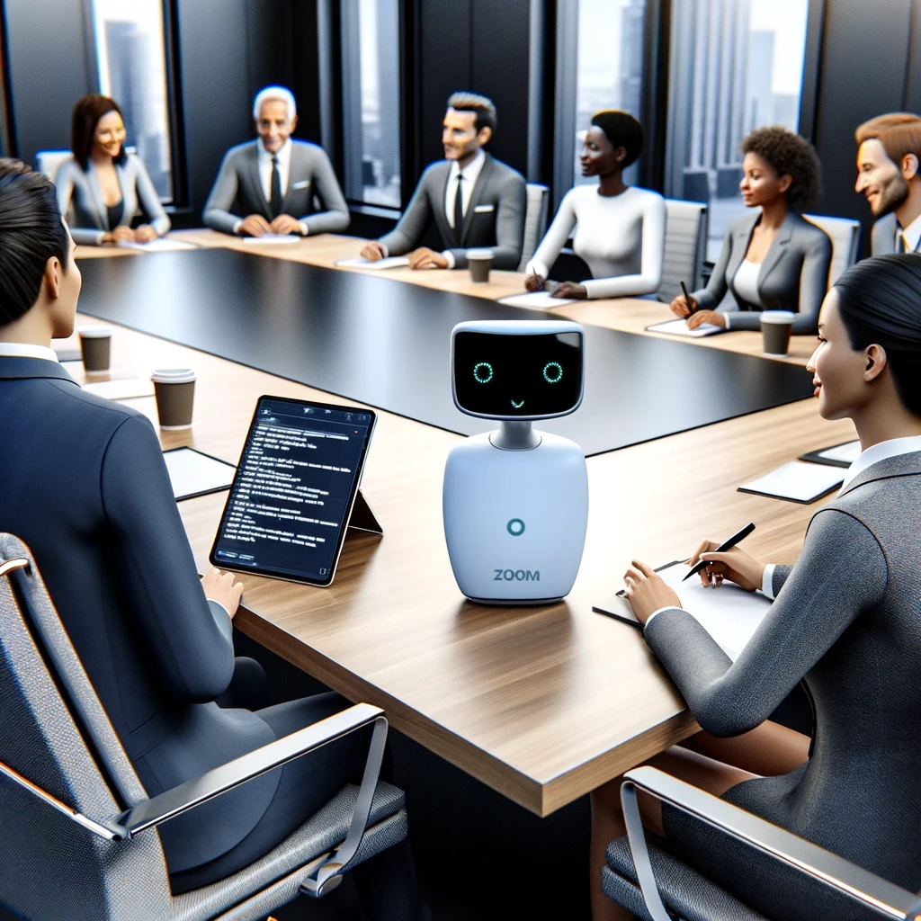
Using Zoom AI Companion in meetings Part 2

Slide 2

“I mute myself on Zoom calls so I can yell at my family without anyone knowing.”

Slide 3




Notes:
https://www.youtube.com/channel/UC35ZpwldGw7ZJ5R-2sLijzw

Slide 4
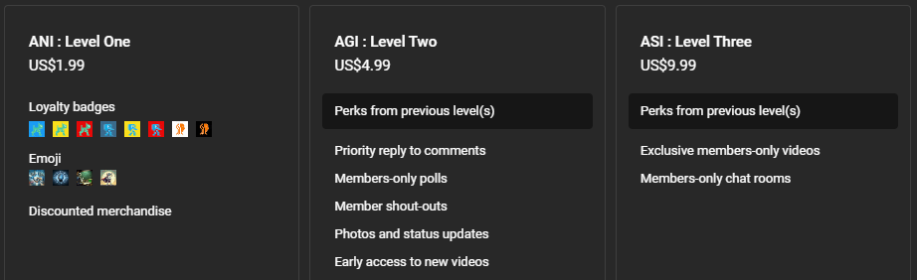
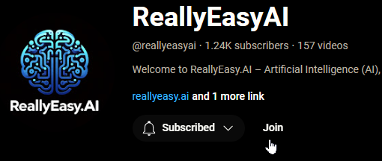
Membership has its privileges
Notes:
https://www.youtube.com/channel/UC35ZpwldGw7ZJ5R-2sLijzw/join

Slide 5
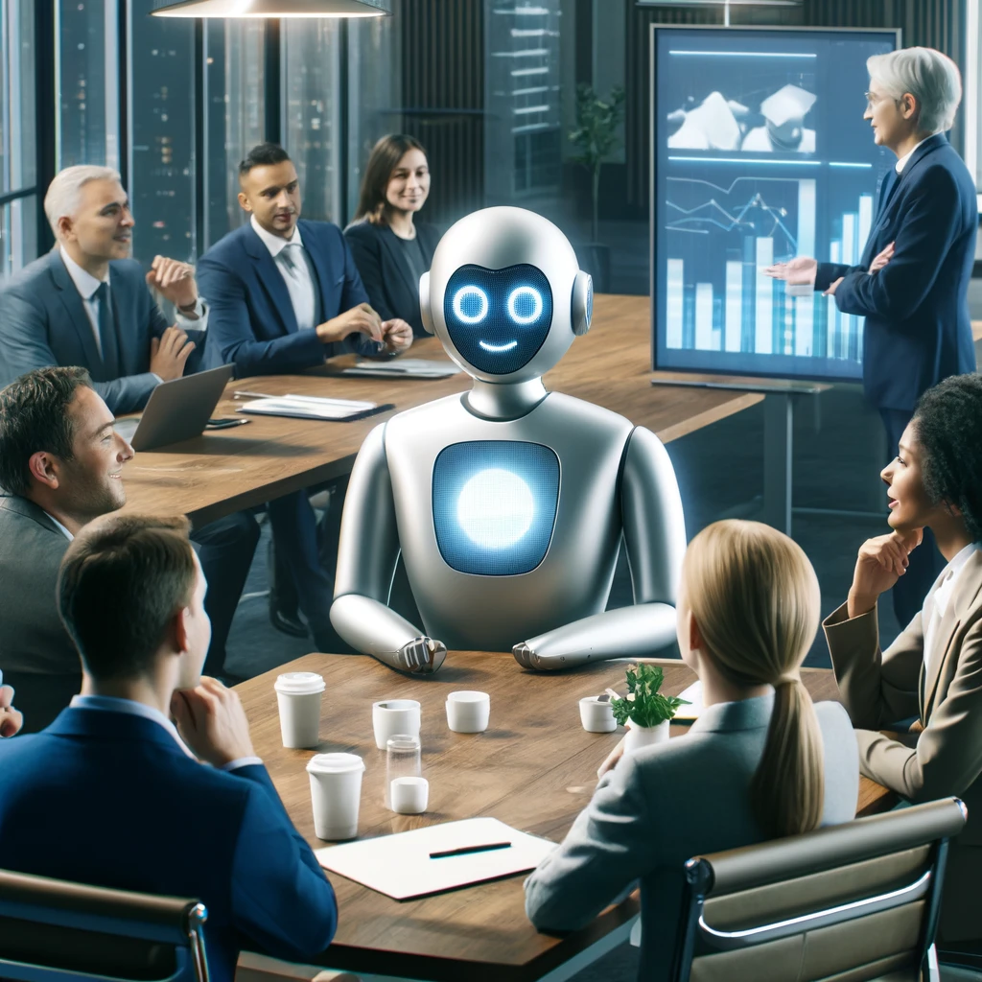
Ai Companion Meeting Features

Slide 6
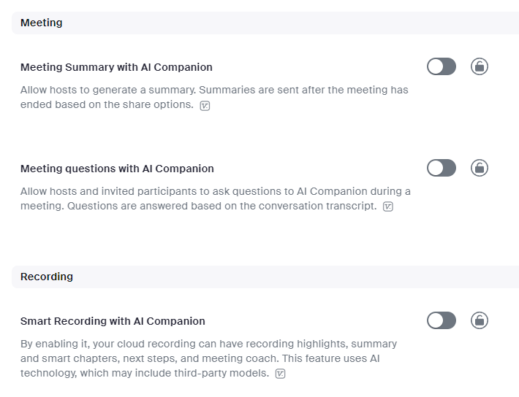

Slide 7
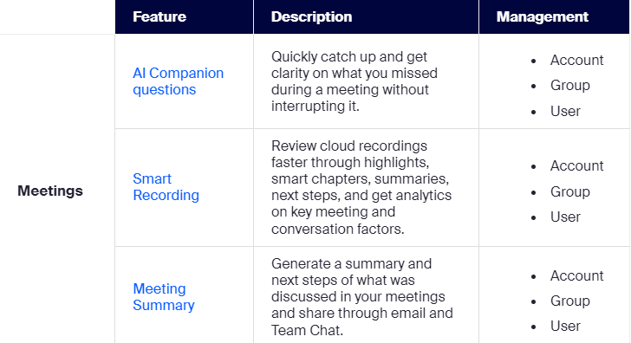

Slide 8
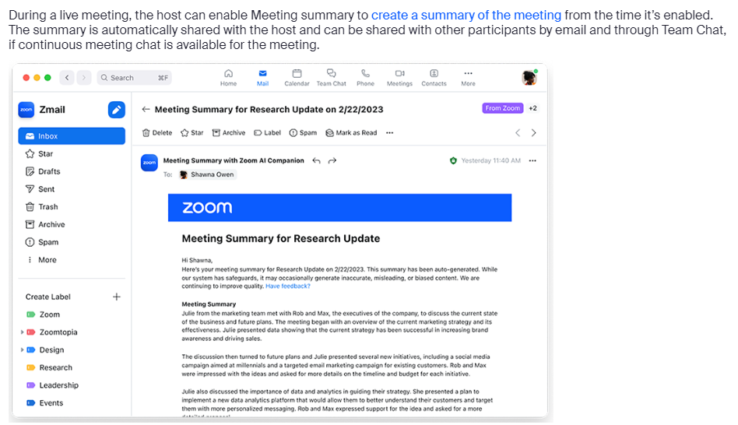

Slide 9
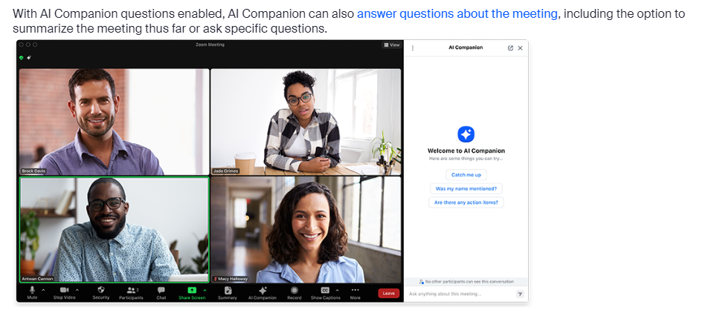

Slide 10
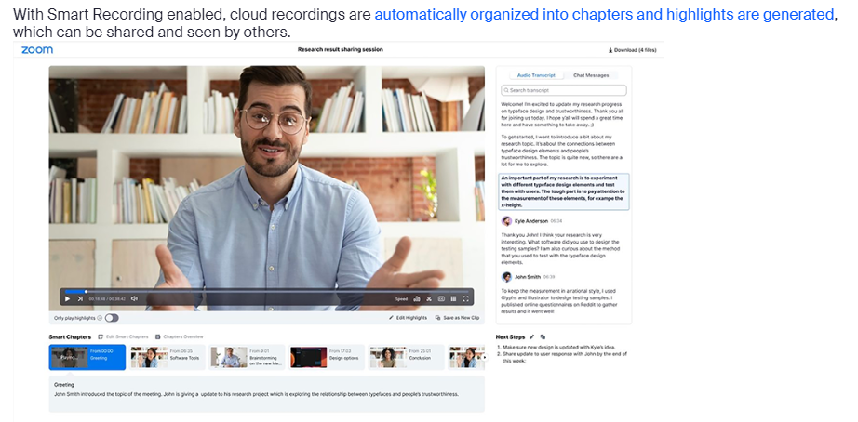

Slide 11


